Slide 1

Maths Workshop Lower School

Slide 2
Aims for this session
To share curriculum expectations
To understand the skills and expectations needed at EYFS and KS1
To identify strategies that can support home learning in number
To explore how the Concrete, Practical, Abstract approach supports learning
To share the Bar Modelling approach for problem solving

Slide 3


Before we begin….
What is your experience of Maths from childhood?
Share and discuss
Notes:
Importance of showing that a problem is only a problem if they cannot solve it, to persevere, to have self-belief and the determination to succeed in solving the problems in order to be the best mathematicians that they can be.

Slide 4
Curriculum expectations
The EYFS have early learning goals.
The national curriculum for mathematics aims to ensure that all pupils:
become fluent in mathematics
develop conceptual understanding and the ability to recall and apply knowledge rapidly and accurately
reason mathematically by following a line of enquiry, conjecturing relationships and generalisations, and developing an argument, justification or proof using mathematical language
can solve problems by applying their mathematics to a variety or routine and non-routine problems with increasing sophistication, including breaking down problems into a series of simpler steps and persevering in seeking solutions
Notes:
Fluency – use key words from the NC -–is more than chn being able to recall facts quickly but instead, it is about chn having a deep, flexible and adaptable understanding of Maths concepts. To promote fluency, Lessons and resources need to be crafted carefully to foster deep conceptual and procedural knowledge. .
If children are not fluent in basic facts, then when they are solving more complex problems, the working memory is taken up by calculating basic facts, and children have less working memory to focus on solving the actual problem So fluency in basic facts allows children to tackle more complex maths more effectively.
Children need to be taught strategies to solve number facts. most children don’t magically become fluent in these facts. If they aren’t explicitly taught to solve e.g. 6 + 7 by thinking ‘double 6 and one more’ or to solve 12 – 8 by using 'find the difference' strategies, then many children will get stuck on inefficient counting based approaches
Reasoning enables chn to make use of all their other mathematical skills when faced with a mathematical challenge. – discuss nrich – reasoning is systematic thinking
A conjecture is a mathematical statement that has not yet been rigorously proved. Conjectures arise when one notices a pattern that holds true for many cases.
Non routine problems are problems that are out of context where chn can apply their learning securely in a range of different contexts

Slide 5
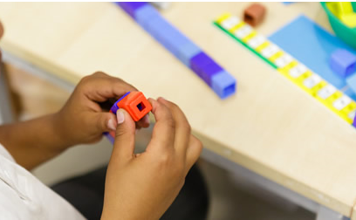
Skills in Maths and across the curriculum
Use Mathematical vocabulary
Explain ideas and evaluate outcomes
Make connections
Use fluency and recall
Predict and Justify
challenge ideas
Work systematically
Trial and improvement
Logical thinking
Be independent
Learn from mistakes
Collaborate with others
Spot patterns
Show resilience
Correct mistakes
Notes:
At grange park we would like all chn to develop these skills

Slide 6
EYFS
Number bags – numeral to pictures (subitise)
Count to 20 and beyond, know compostition to 5 then 10
Ordering, comparing, one more, one less, fewer
Odd and even – number blocks
Double
Maths through play and everyday interactions

Slide 7
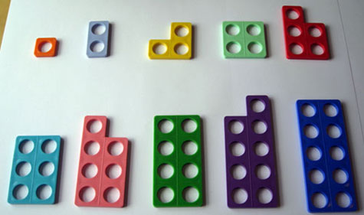
Reception
Practical fun!

Slide 8
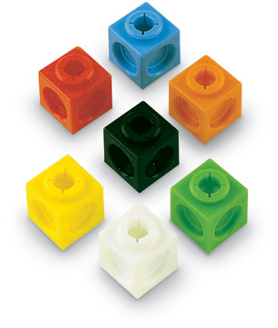
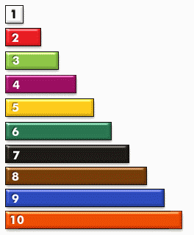
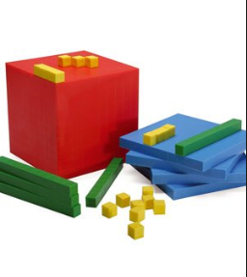
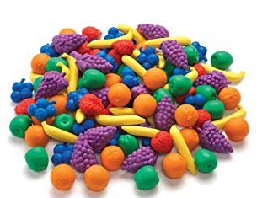
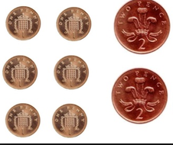
Manipulatives used in class to support understanding
Notes:
But every day objects are great – exposing chn to a range of different contexts and applying their learning

Slide 9


The National Curriculum

Slide 10
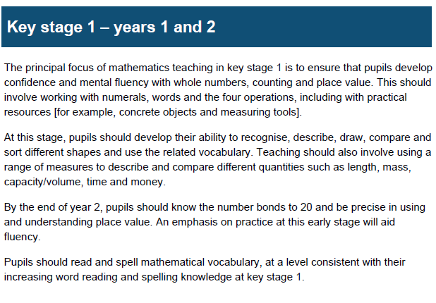
Expectations by the end of KS1

Slide 11
Concrete, pictorial, abstract approach
Concrete
Actual objects to illustrate the problem
Generic concrete
Materials such as multilink & dienes,
Pictorial representations
Individual squares, joined squares and then rectangular bars
Abstract
Written methods
Build it … Draw it… Write it…..Say it.

Slide 12
Strategies using objects multiplication
Play a mystery game with your child using a feely bag ‘Which multiplication am I?’ e.g pull out 10 cubes and organise into 2 groups. Ask your child to say the number sentence and then write it eg 5x 2 = 10
Using concrete objects on your table, a feely bag and dice. Without looking in the bag, pull out either 2, 5 or 10. Now roll the dice eg your child pulls out 5 cubes and rolls the dice to reveal 3. This becomes 5 x 3. Your child needs to show 5 , 3 times with that object (3 groups of 5).
Have a go at this with someone on your table:
Using any objects on your table, show 5 lots of 3. Now show 3 lots of 5.
Notes:
Teachers in Key Stage 1 will teach children how to count in 2s, 5s and 10s and make sure they are very confident in this, before going on to show them how to work out times table problems like this one using arrays.
This is because children need to be able to count up in steps of different numbers before they can use arrays to help them.

Slide 13
Addition and Subtraction
Your turn!!
If I know 7 + 3 = 10, 3+7 = 10 , 17 + 3= 20, 70 + 30 = 100 etc
7+5 = 7 +3 + 2 = 12
7+5+3 = 15
2 digit add one and subtract one, count forwards and backwards over the 10

Slide 14
Let’s explore!
Partition
Fact families
Part whole model
Bar models
Missing numbers
Base ten, dienes, add subtract 2 digit numbers, partition, practical, draw it out, mental methods,

Slide 15
Multiplication and Division
Practical – 3 bags with 5 pennies in, 15 sweets and share them between 5,
Arrays, commutative law
Repeated addition
Link to division

Slide 16
Fractions
Practical – pizza, cake, sweets,
Fractions shape and amount
½ and ¼
Can you have a bigger half?
Bar models

Slide 17
Language of Maths
+, plus, add, how much more is…..?
- , subtract, minus, how much less is, fewer……?
Half, halve
=, equals, sign, tens, ones
Counting up
Number sentences
Digits
Double, halve, share, left over,
Near doubles
Count in 2s,5s and 10s
Groups of

Slide 18
Mastery v Acceleration
promotes procedural learning at the expense of deep understanding
shallow mastery
leads to apparent success without students developing the depth and tenacity that is needed for long-term progression.
shallow acquaintance can also lead to learners feeling insecure

Slide 19
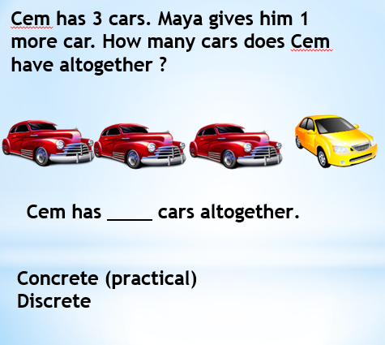
Concrete, pictorial, abstract approach
Have a go at using the concrete objects on the table to illustrate the problem in groups
Now draw it using pictorial representations
Individual squares, joined squares and then rectangular bars on post it notes
Finally, how would this be recorded as a written method?
Build it … Draw it… Write it…..Say it.

Slide 20


Cem has 3 cars. Maya gives him 1 more car. How many cars does Cem have altogether ?
Cem has ____ cars altogether.
Concrete (practical)
Discrete - part – part - whole

Slide 21

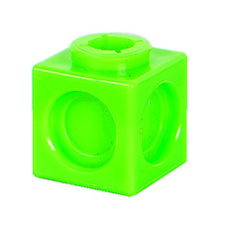
Cem has 3 cars. Maya gives him 1 more car. How many cars does Cem have altogether ?
Cem has ____ cars altogether.
Generic concrete practical)

Slide 22


Cem has 3 cars. Maya gives him 1 more car. How many cars does Cem have altogether ?
3
1
?
Cem has ____ cars altogether.

Slide 23


Cem has 3 cars. Maya gives him 1 more car. How many cars does Cem have altogether ?
3
1
?
Cem has ____ cars altogether.

Slide 24
Using the CPA approach
How could we apply the CPA method to this problem?
Jon has 10 marbles. Harry gives Jon 12 more marbles. How many marbles does Jon have now?
Jon has ___ marbles.

Slide 25




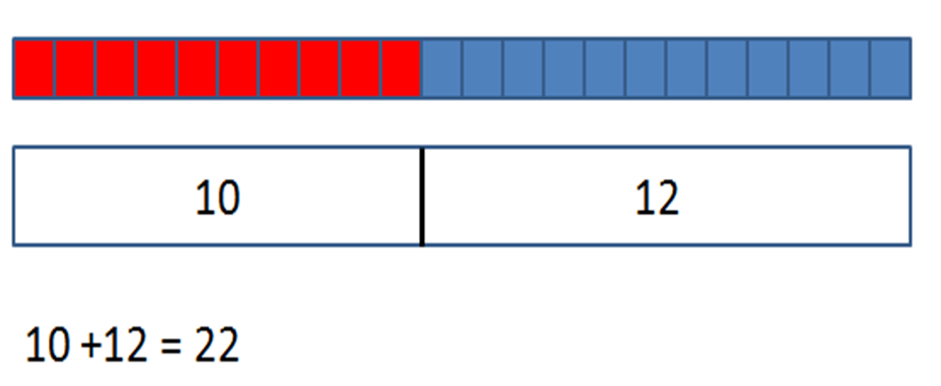
Concrete to pictorial to abstract
Jon has ____ marbles altogether.

Slide 26
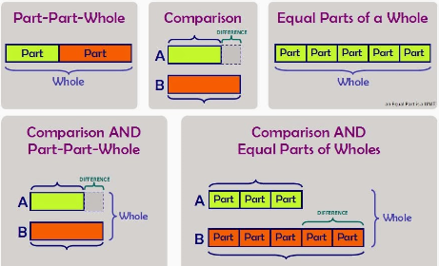
Bar modelling for problem solving as part of CPA approach
Notes:
Bar modelling is part of the concrete > pictorial > abstract (CPA) sequence when teaching certain maths topics. The process starts with using real-world, tangible representations before moving onto showing the problem using pictorial diagrams, and then introducing the abstract algorithms and notations (such as the +, -, x and / symbols).
The bars don’t need to be precisely measured, but they do need to be proportional, so children can see the difference between them and the numbers they represent.
Bar models don’t give you an answer – they give you an understanding of what to do in order to get to the answer. Children need to have strategies to add, subtract multiply and divide for them to use bar models.
Bar modelling is not a ‘quick fix’ tool and will only work if the pupil has a good understanding of key concepts. It’s also important that children set out the bars correctly. If pupils are messy with the bar model or use the wrong model for a problem, this can prevent them from seeing how to solve the problem.

Slide 27
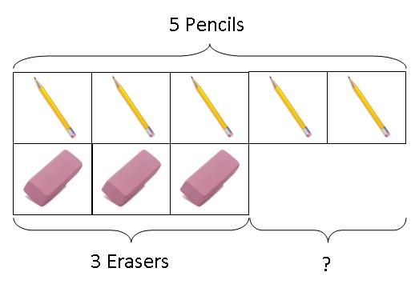
Subtraction/difference: Comparison Model
Zeenat has 5 pencils and 3 erasers.
How many more pencils than erasers does she have?
Zeenat has ___ more pencils than erasers.

Slide 28
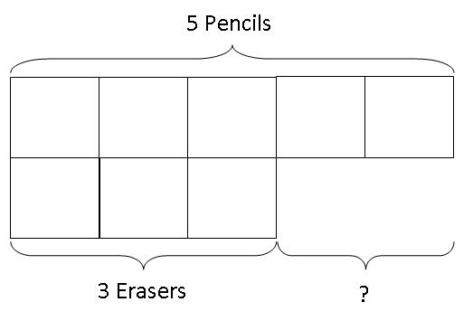
Moving to the abstract
Zeenat has 5 pencils and 3 erasers.
How many more pencils than erasers does she have?
erasers
Zeenat has ___ pencils than erasers.

Slide 29
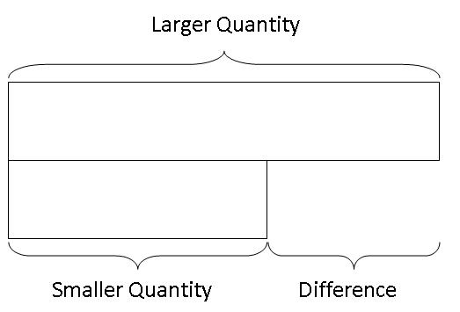
Generalisation

Slide 30
Try these using bar models
The farmer has 24 animals There are three times
as many sheep as cows.
How many Sheep does the farmer have?
How many cows does the farmer have?

Slide 31
Thank you for coming
I kindly ask that the resources be placed neatly on the tables.

