Slide 2
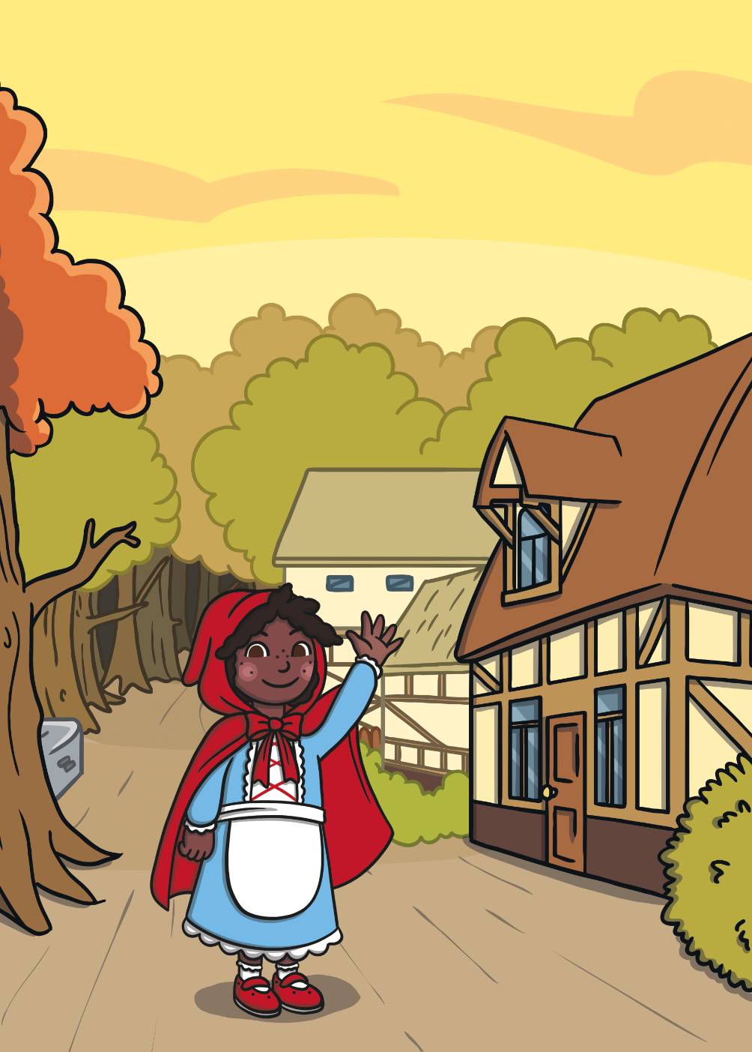
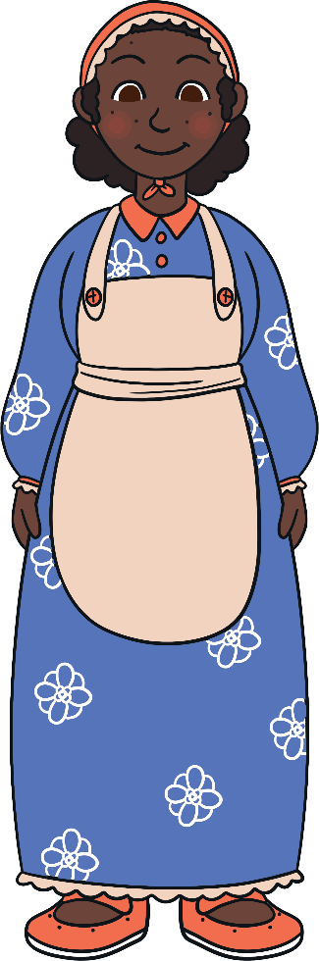
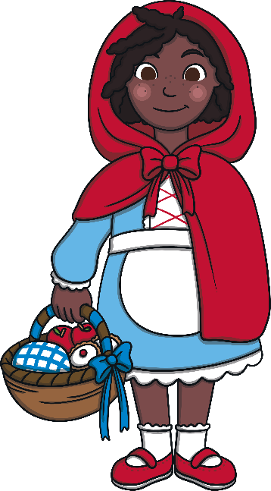
Once upon a time there was a girl called Little Red Riding Hood.
She lived with her mother in a village near a forest.

Slide 3
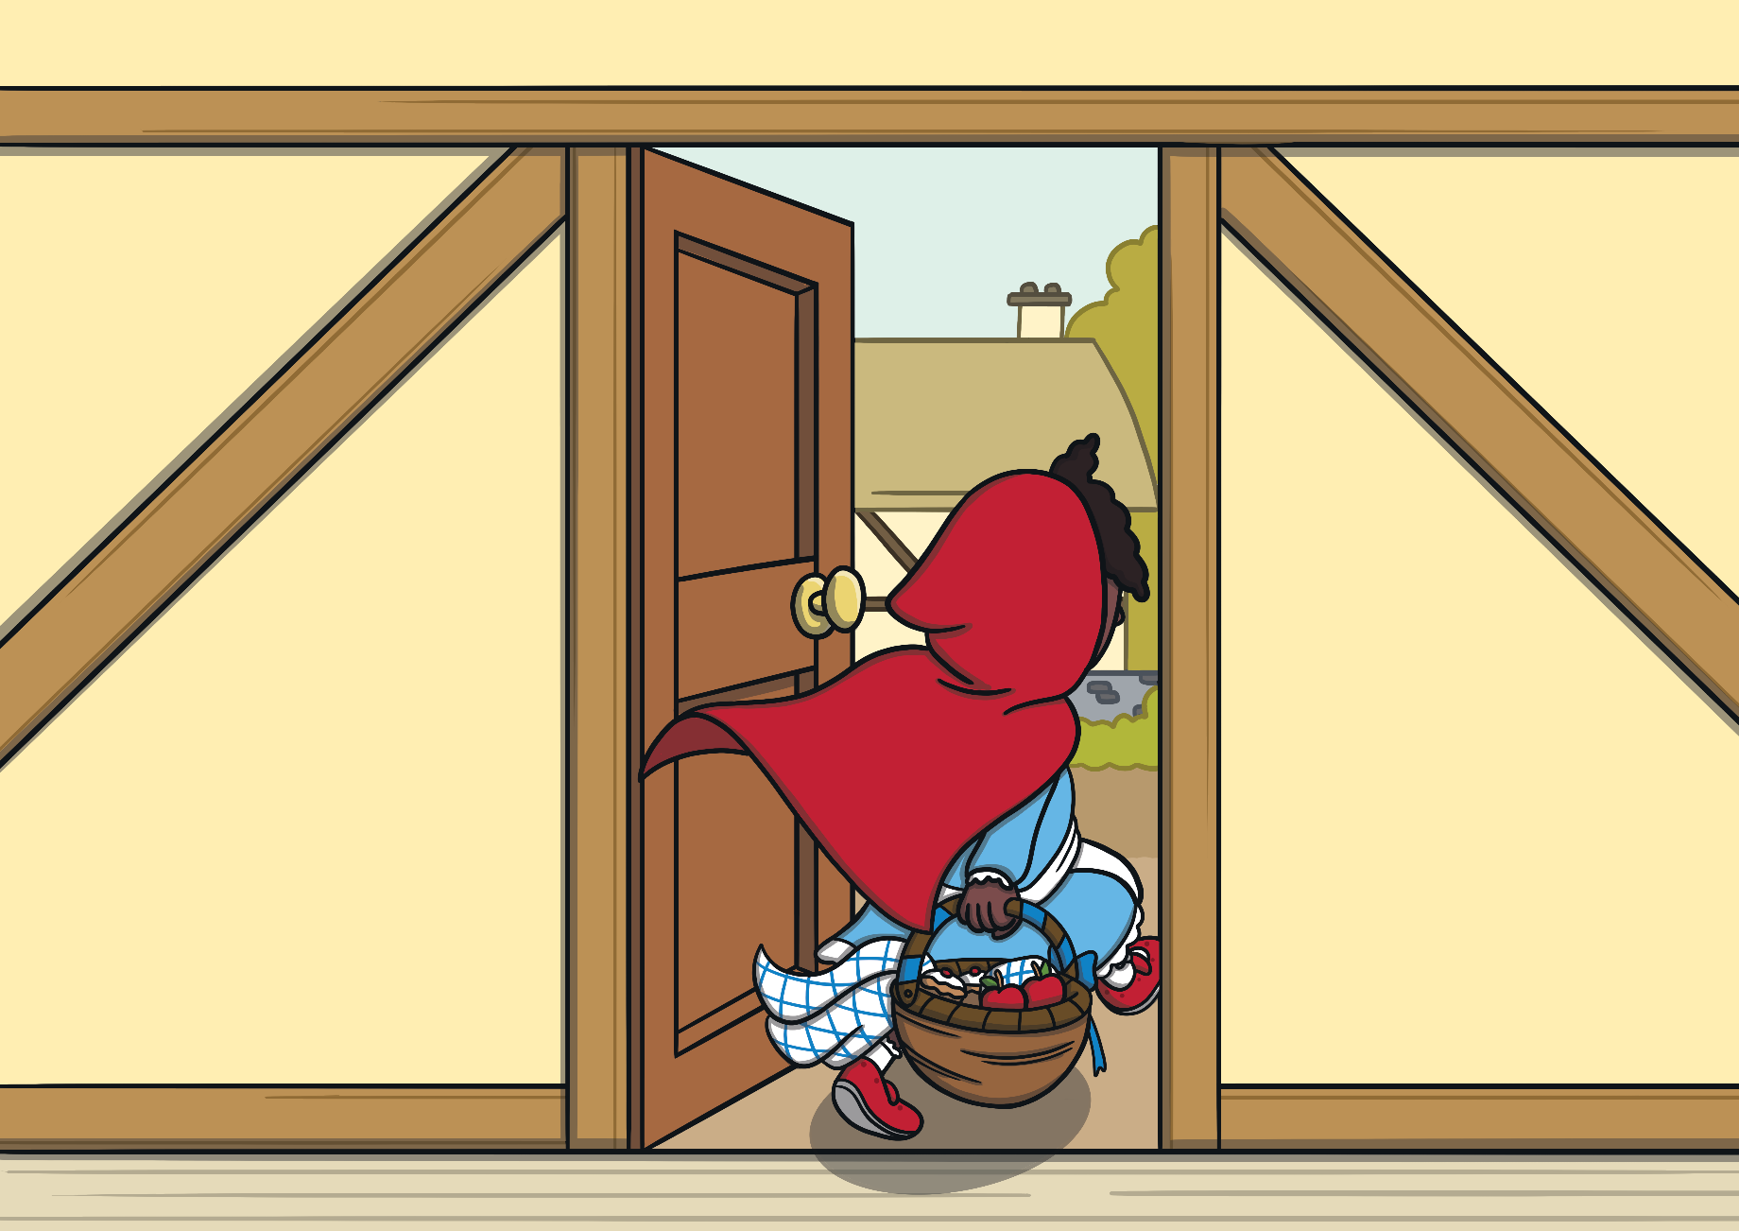
One day, Little Red Riding Hood went to visit her grandmother.
She took a basket of food with her.

Slide 4
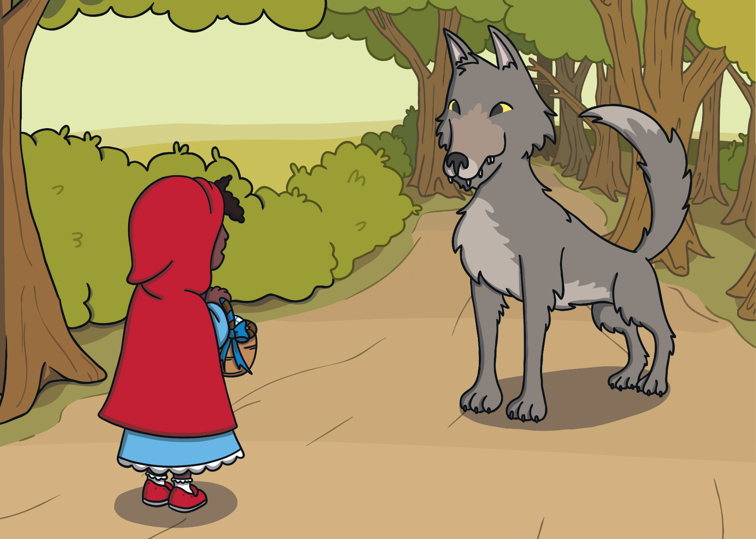
On her way, Little Red Riding Hood met a wolf. “Hello,” said the wolf. “Where are you going?”
“I’m going to visit my grandmother who lives in the forest,” explained Little Red Riding Hood.

Slide 5
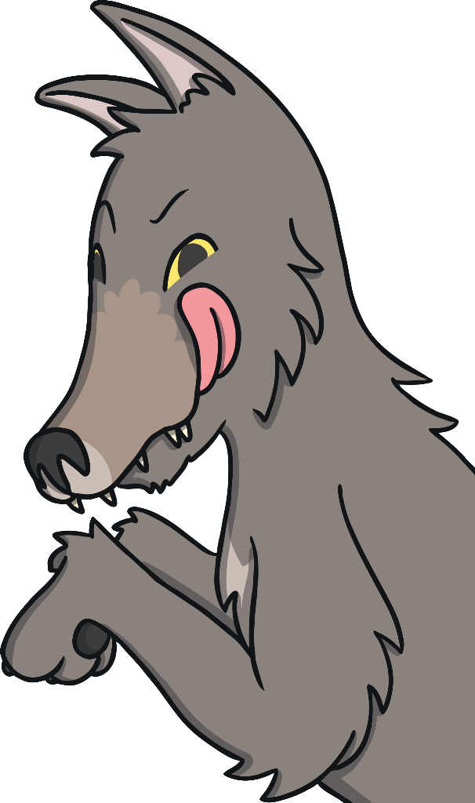
The wolf ran to her grandmother’s house. He went inside and locked her in the wardrobe! He put on her nightgown and got into her bed.

Slide 6
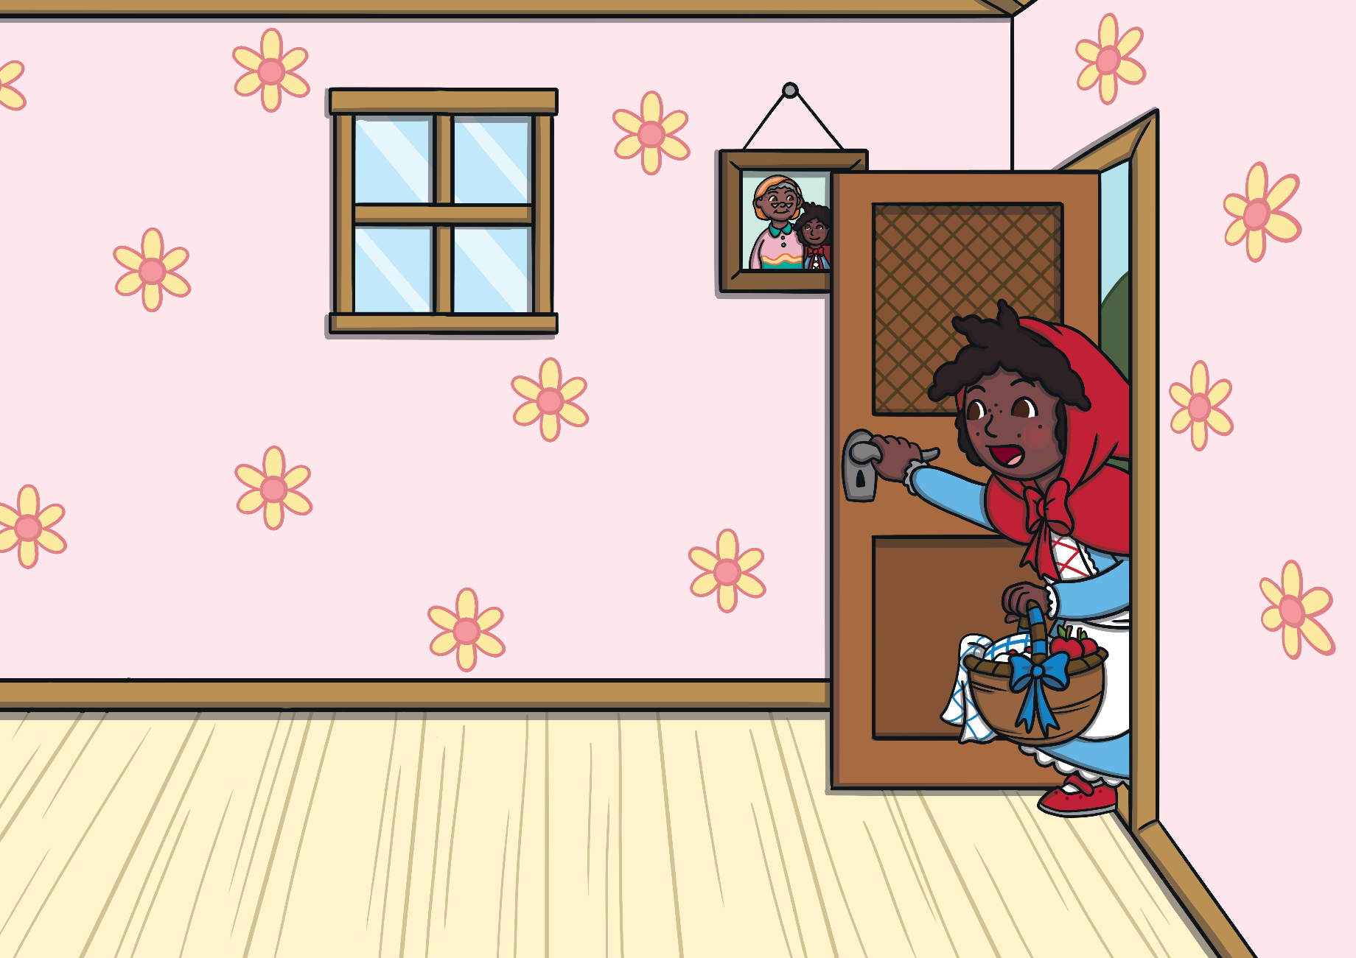
A little later, Little Red Riding Hood came to the house. She knocked on the door, then went inside.

Slide 7
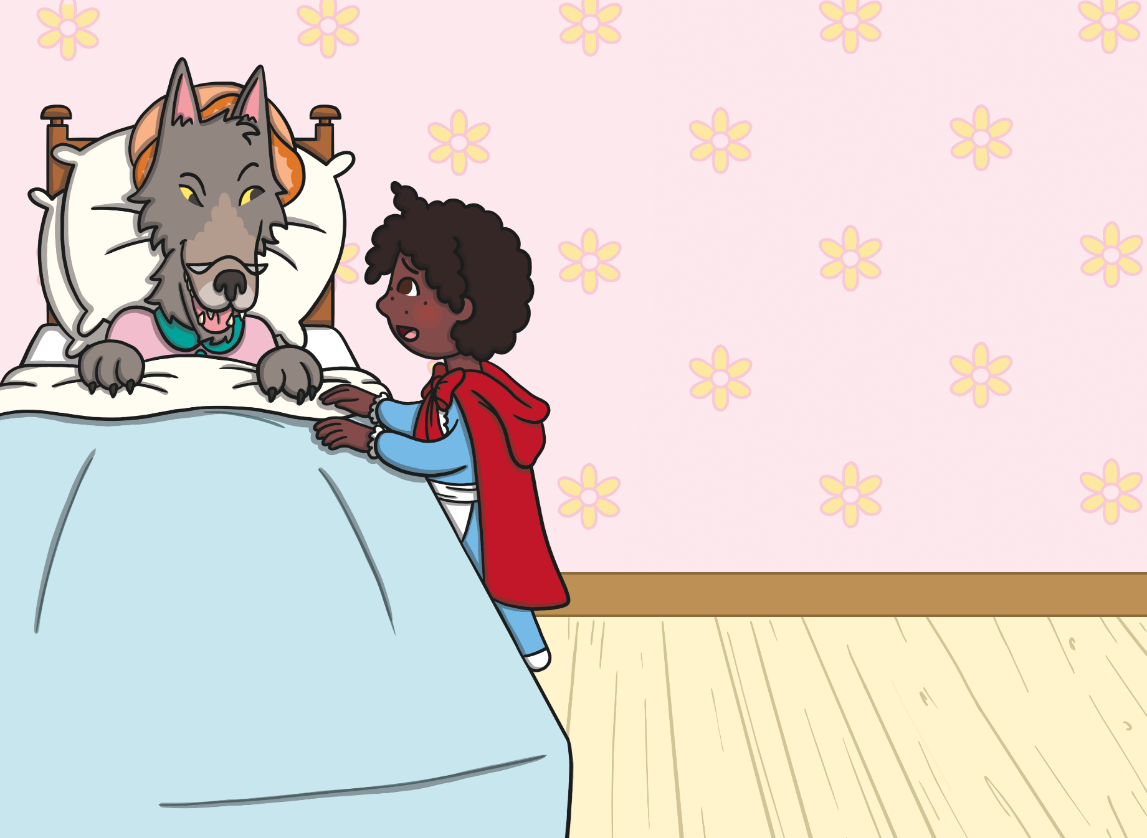
Little Red Riding Hood went over to Grandmother’s bed.
“Oh Granny, what big ears you have,” she said.
“All the better to hear you with,” answered the wolf.

Slide 8
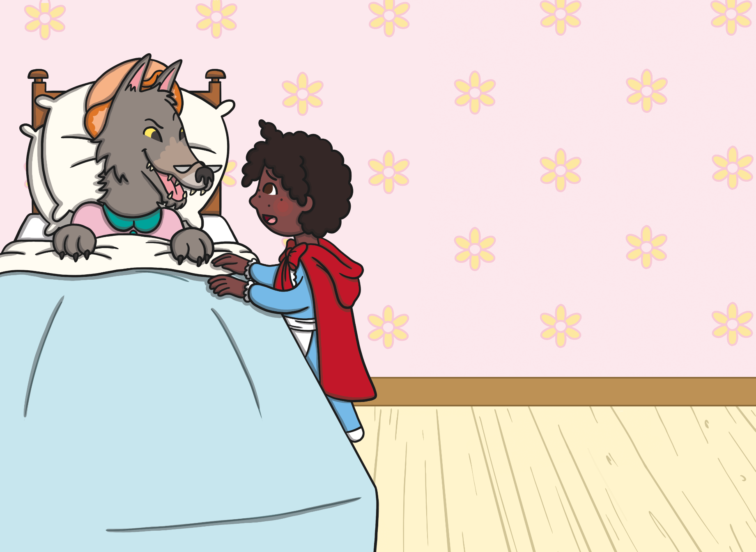
“Oh Granny, what big eyes you have,” said Little Red Riding Hood.
“All the better to see you with,” replied the wolf.

Slide 9
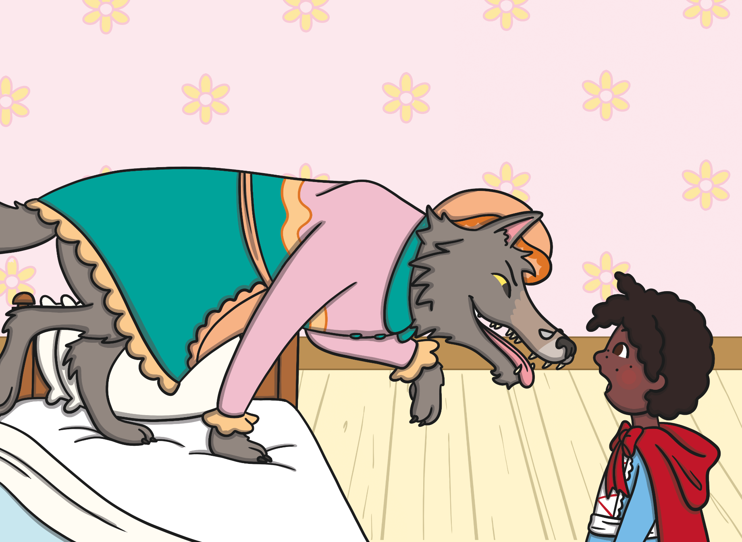
“Oh Granny, what big teeth you have,”
said Little Red Riding Hood.
“All the better to eat you with,” said the wolf.

Slide 10
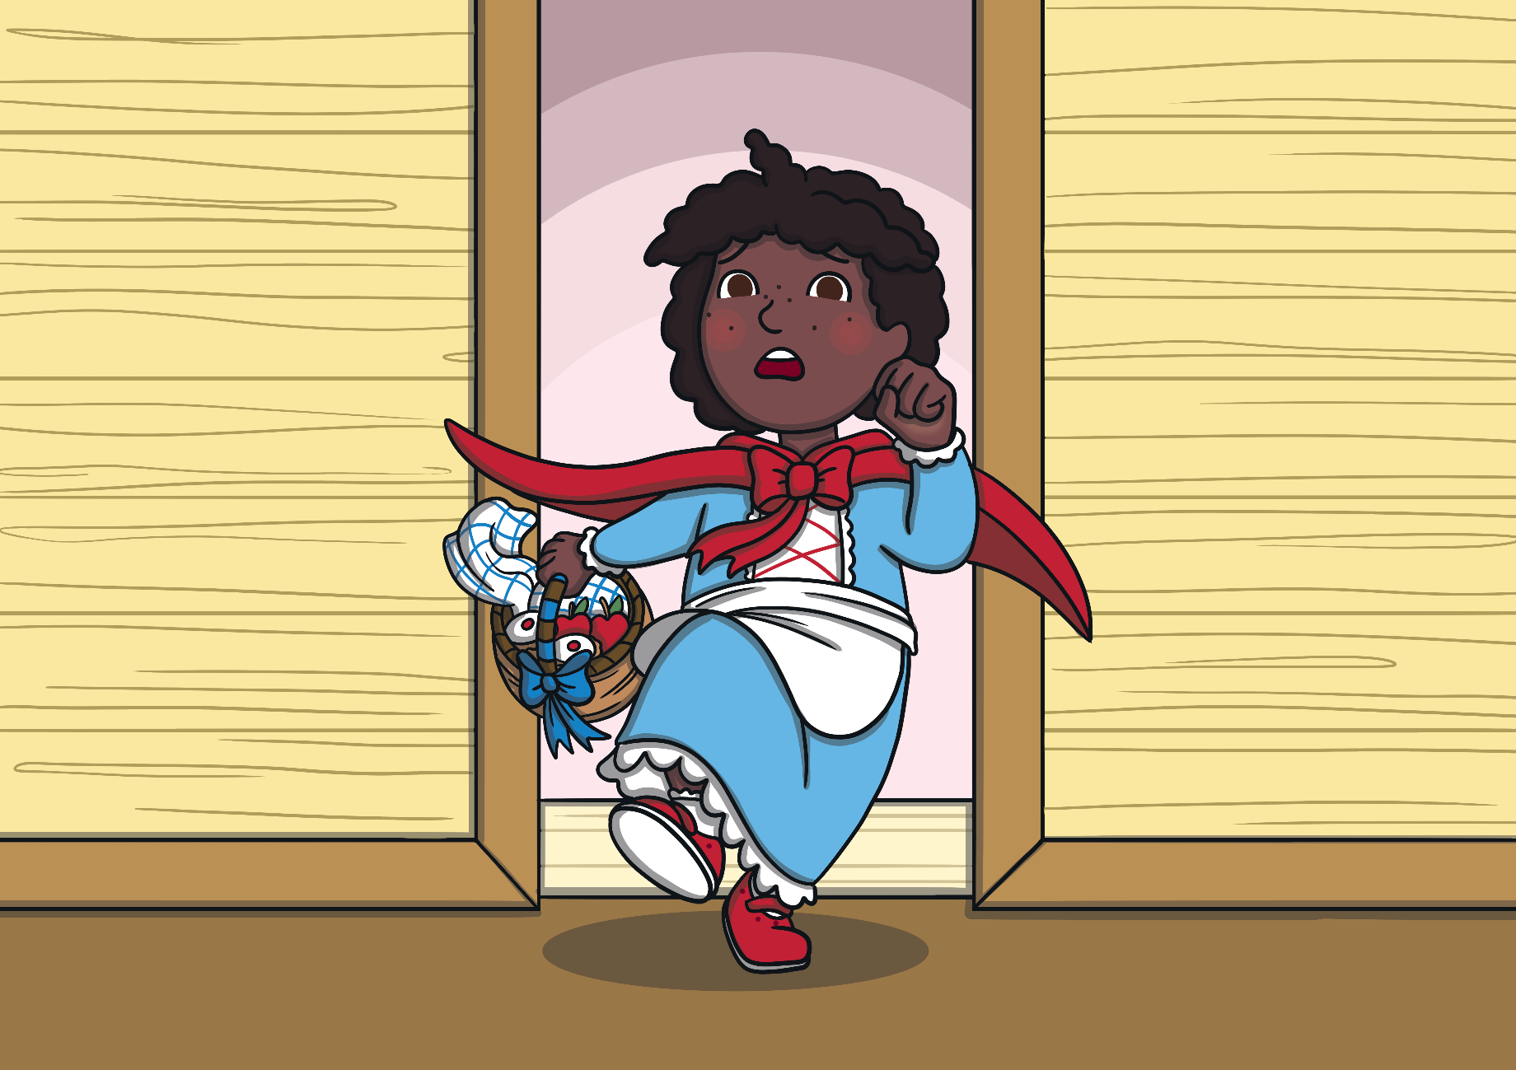
“Help!” shouted Little Red Riding Hood as she realised that there was a wolf in her grandmother’s bed.
She ran out of the house.

Slide 11
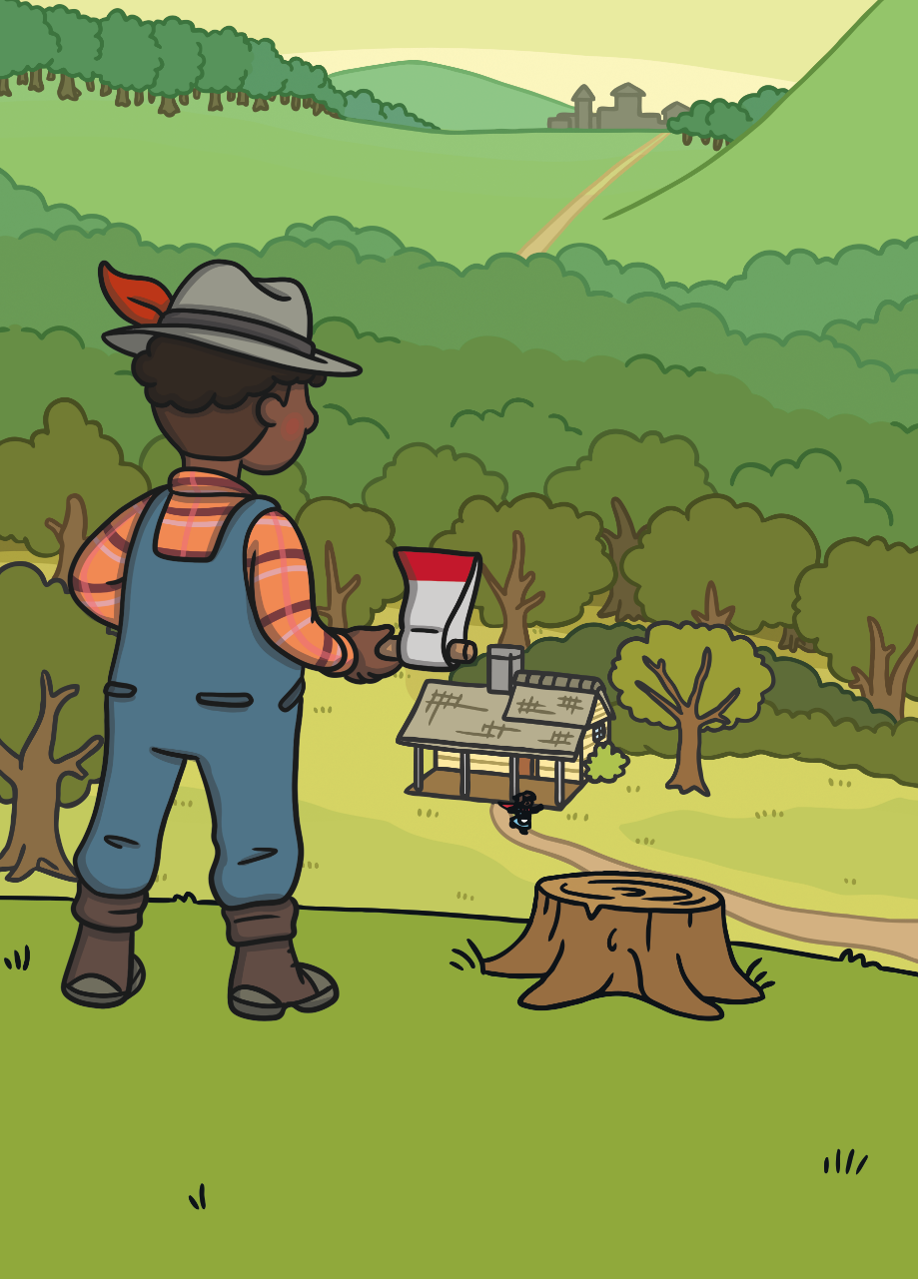
A woodcutter was nearby. He heard Little Red Riding Hood’s scream and ran to the house.

Slide 12
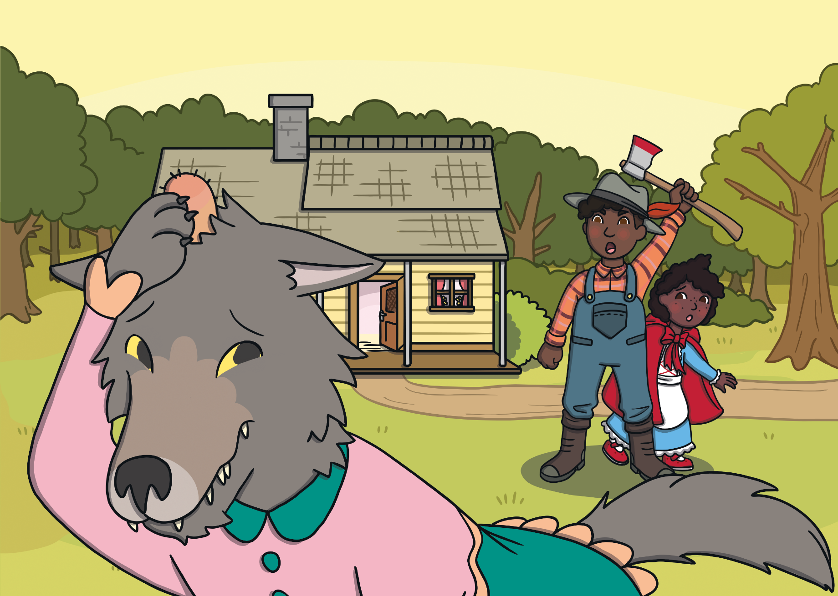
The woodcutter hit the wolf over the head.
The wolf ran away and Little Red Riding Hood never saw him again.

